Slide 1
Video PowerPoint Template
How to make good visuals for your knowledge clip

Slide 2
Tips & Tricks
The first few slides are instructions on the best ways to use your PowerPoint

Slide 3


Show & Tell
Make a strong connection between visuals and spoken text
What do I show?
What do I tell?

Slide 4




Mix & Match
Choose the right visual for your content
1. Image
2. Video
3. Schema/graph
4. Quote
5. Bullet points

Slide 5
Template

Slide 6

PLEASE EDIT TITLES WITHIN THE RED LINES
Tips for good lay-out
YOU
Title: max 2 lines,
Font size (60 – 80)
Bullets: Font size (45 – 55)
- Use this textbox for sum ups
- Line spacing: ‘12 pnt before’
- Use numbers for sequencing and bullets for sum ups
*Important: Please delete the red lines
and photo before you record the presentation.

Slide 7
1. Bullet Points
Use this textbox for sum ups
Make a direct relation between speech and bullets
Use keywords instead
of full sentences

Slide 8
2. Quote
“This is a short quote that only spans a few lines. For longer quotes, use the full screen slide.”
Name Author, Year

Slide 9
“Use the fullscreen option if you want to emphasise
a quote, or if the quote is long. If the quote is too long, either divide it into two slides or shorten it. If you want to stress a word make it bold or underlined. Make sure the font size is large enough to be read. And also, remember to read your quote out loud!”

Slide 10
Tips:
For a quick explanation put the image next to you
If you want to highlight parts or animate the image, make it full screen (see next slide)
3. Schema/ graph

Slide 11
Tips:
Highlight important parts of your diagram with a different color;
If you are not able to animate it yourself, give a clear explanation about what it should look like.
1
2
3
4

Slide 12
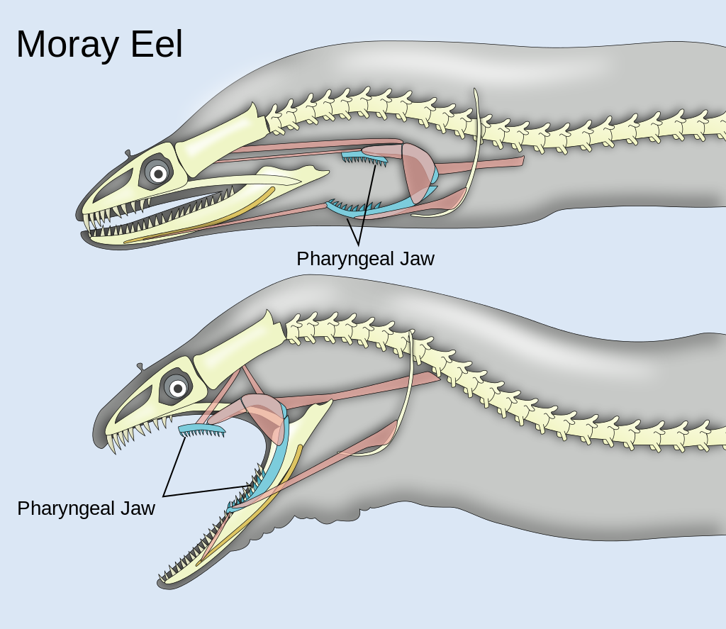
Tips:
Make sure you check the usage rights of the images (public domain, creative commons or fair use).
If you want to highlight specific parts in your image, make it full screen.
4. Image

Slide 13
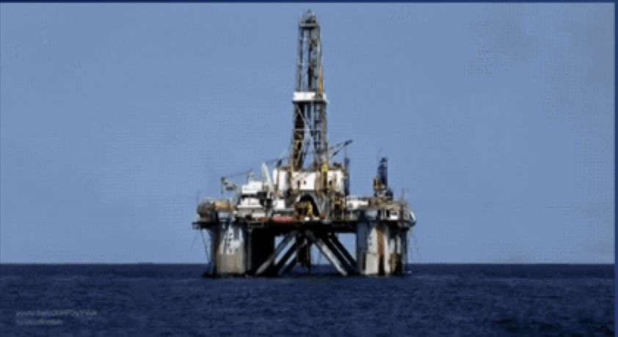
Tips:
Make sure you check the usage rights of the video. Find a stock video, a public domain or creative commons clip, or make your own video fragment.
Always show video full screen. You can show a still image before playing the video, as shown here.
5. Video

Slide 14
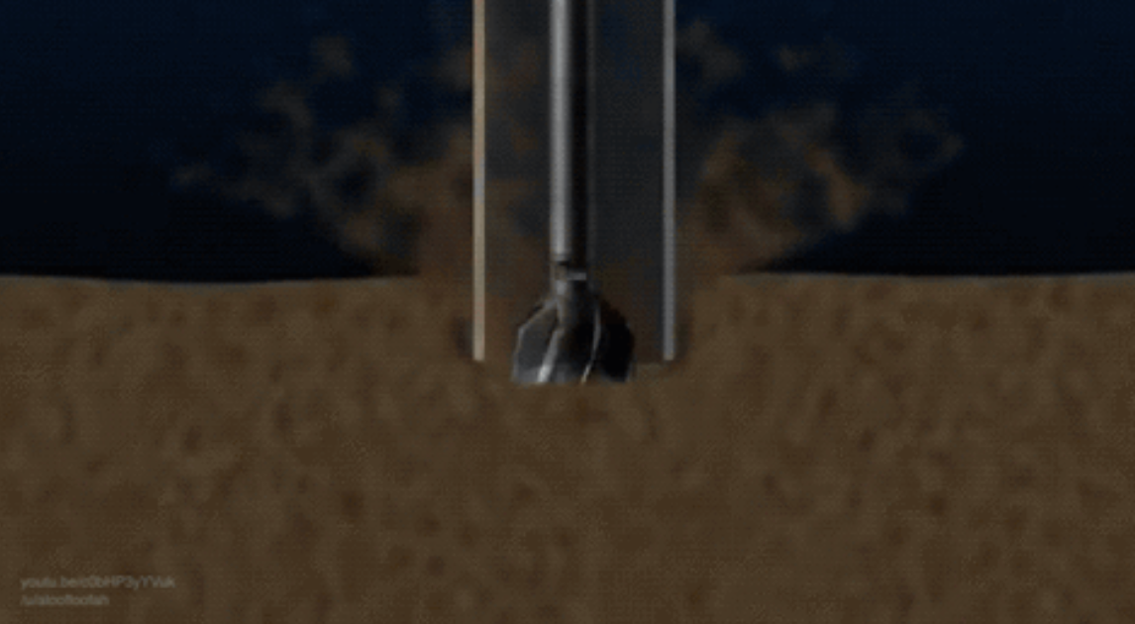
5. Fullscreen video

Slide 15

Tips:
Keep in mind: No sources = no video!
6. Sources
Christopher Holm-Hansen (speech bubble)
Robin Richards (image)
Chris Brunskill (bullet points)
David Courey (quote)
Danil Polshin (diagram)
Alfa design (video)
Offshore deepwater drilling process (https://youtu.be/c0bHP3yYVuk)
Ryan Wilson (pbroks13) (Pharyngeal jaws of moray eels)
Notes:
‹#›

Slide 16

This video by Leiden University is licensed under a
Creative Commons Attribution-NonCommercial-ShareAlike 4.0 License* (see https://creativecommons.org/licenses/by-nc-sa/4.0/legalcode).
Contact: fill in your email address
*this is only the case when ALL images are CC
Notes:
‹#›

